Slide 1

Explore, visualise and share data
Jan 2013

Slide 2
What is Data Unity?
Suite of online Open Data tools
Explore data using Data Explorer tool
Prettify data with graphics
Share visualisations anywhere
Scalable (cloud based)

Slide 3
Why is Data Unity needed?
Lots of data out there, need to get insights from it
Often data results aren’t friendly so people don’t engage with them
A lot of popular data tools (like spreadsheets) don't allow insights to be shared easily. Results should be sharable in context (sites, blogs, twitter, etc), not stuck in one system
Collaborating on data means clearer, cleaner data for everyone

Slide 4
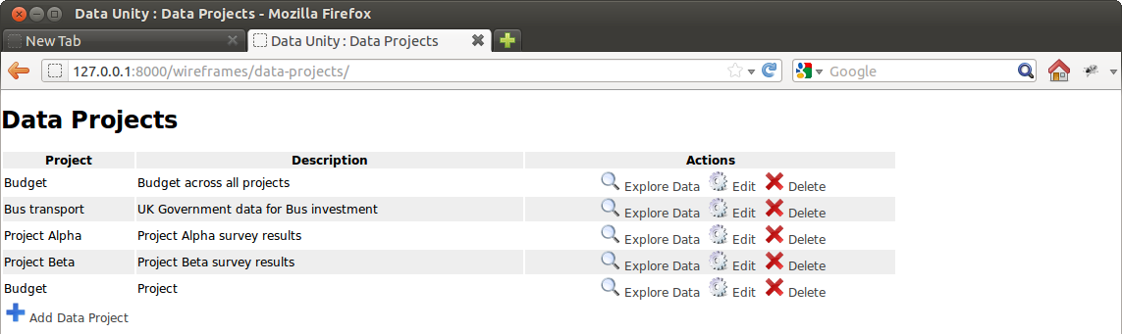
How do you use Data Unity?
Select the data set you are interested in:

Slide 5
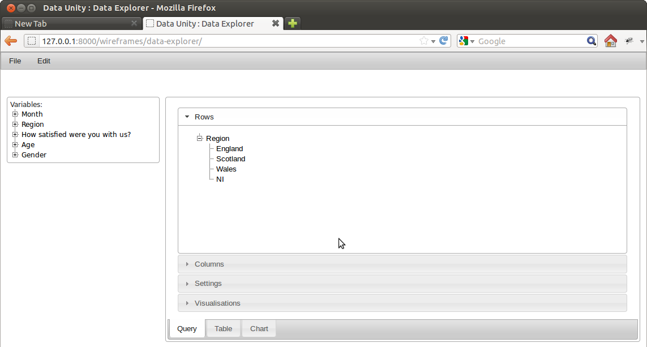
How do you use Data Unity?
Drag and drop to create a query:

Slide 6
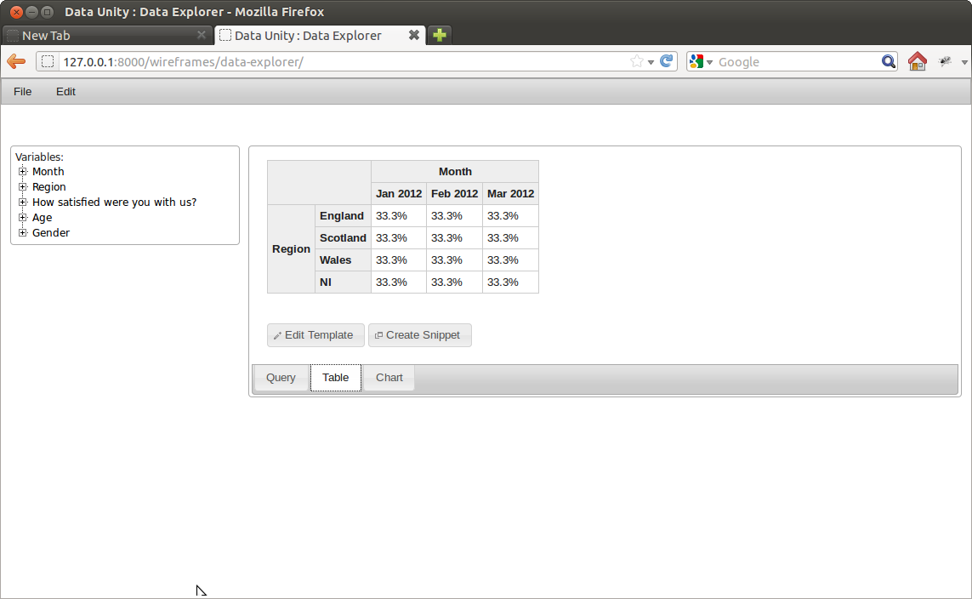
How do you use Data Unity?
Review results:

Slide 7
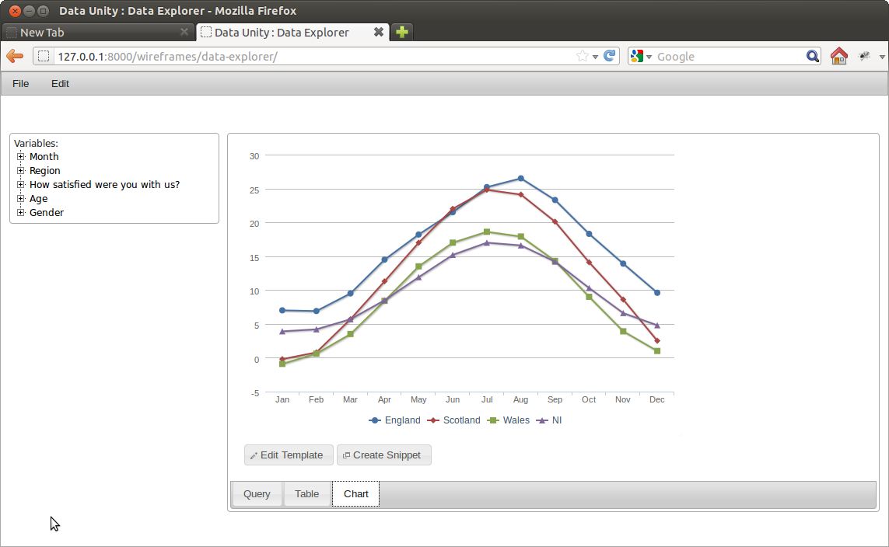
How do you use Data Unity?
Visualise data:

Slide 8
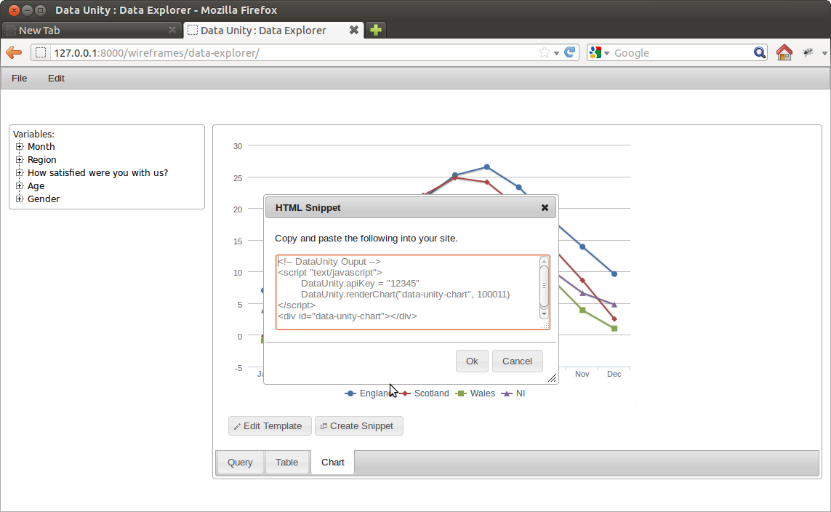
How do you use Data Unity?
Share data:

Slide 9
Find out more
www.dataunity.org
kev@dataunity.org
http://twitter.com/dataunitynews
Ask me!

